Slide 1
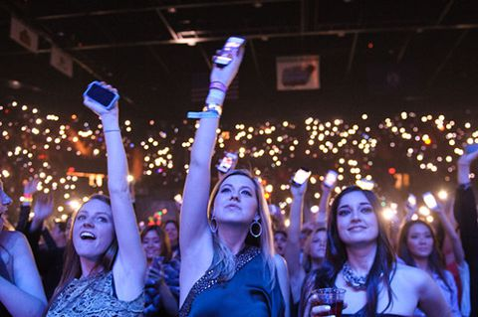




BSF
An App to Protect Women
In Real–Time , Real-Life
Powered by

Slide 2


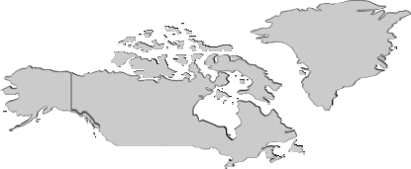

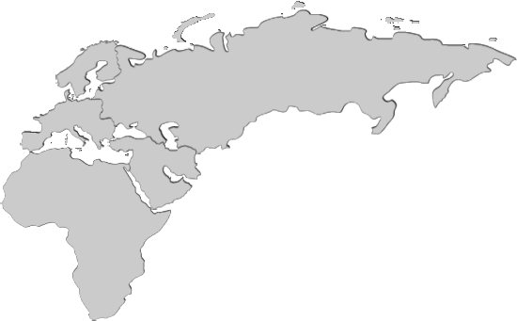




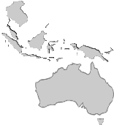

MOBILE PENITRATION AND M-COMMERCE USES
Russia
110 Mn
M-commerce
Opportunity
Ireland
78 Mn
UAE
17 Mn
USA
305 Mn
Japan
58 Mn
Saudi Arabia
50 Mn
India
600 Mn
Nigeria
129 Mn
S. Korea
38 Mn
Brazil
279 Mn
Singapore
8.4 Mn
Indonesia
303 Mn
RSA
59 Mn
USD 1.5 Bn*
Kenya
31 Mn
Smartphone penetration and Shopping Trends are growing worldwide
*Gartner projection-year 2020

Slide 3

PROBLEM STATEMENT
Women don’t feel Safe outside of their doors – In Office / Shopping areas and in crowded Markets ..and there is no way , a Preventive measure can be taken to protect them..
Now Its possible…Via Be Secure Forever !!!!

Slide 4

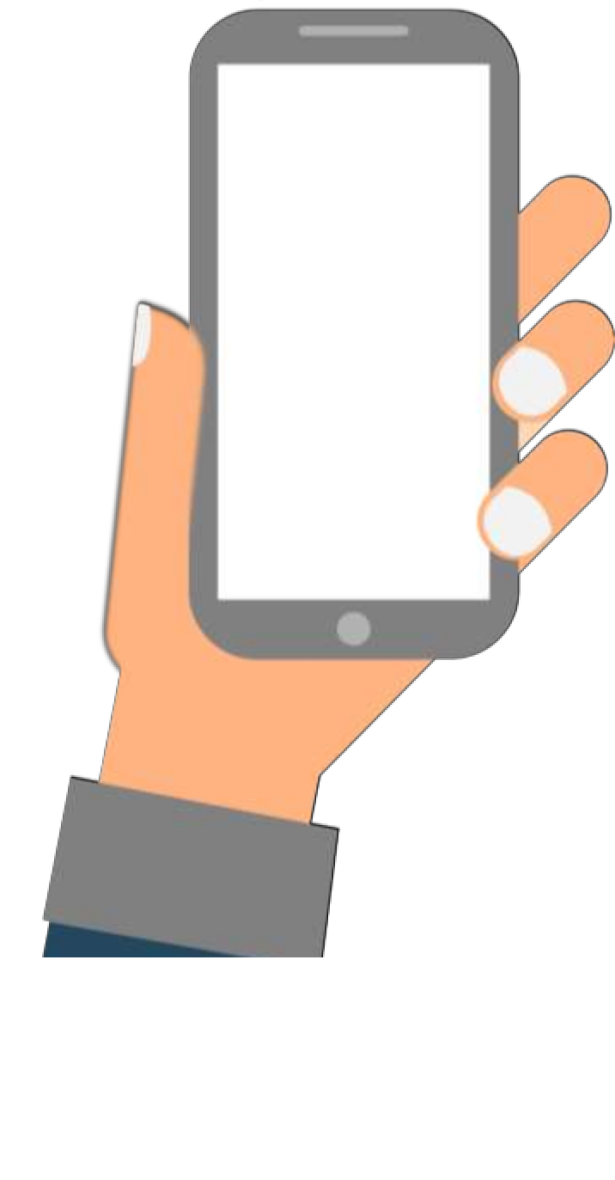
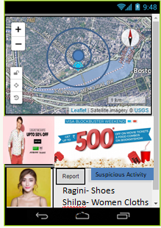









SOLUTION- BSF
Using Facebook/Google Nearby & LBS Functions
ENGAGE
ALERT
CROSS TARGET &
RE-TARGET
INTERACT
REMIND
ATTRIBUTION
Be Secure Forever– an intuitive and interactive platform to inform and alert based on User behavior Analytics captured by Facebook Developer API/Google API*/ Women by Women
Location based Services Function – to Gather the High rated Shops and their Advertisements / Flash Offers based on the Proximity of the shop and end user
Nearby Function Enhancement – A Group Shopping experience by Women , installed BSF App ,having common interest to buy Shoes , cloths etc to get an Bulk offer from a shop
*Proposed

Slide 5
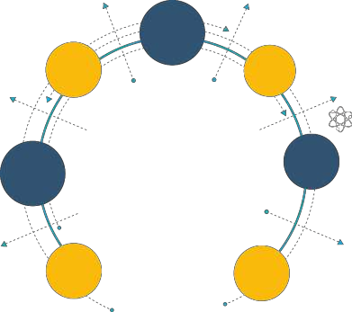

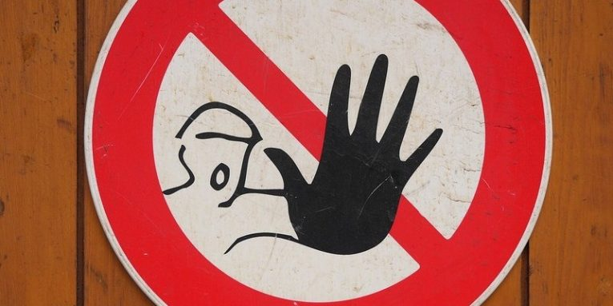


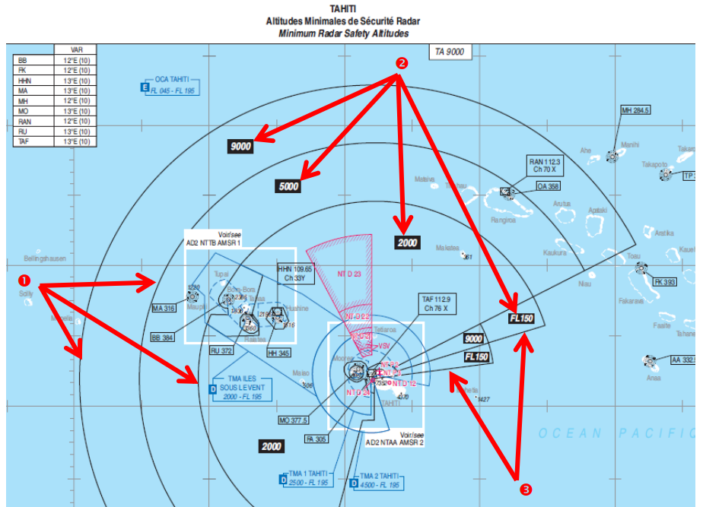







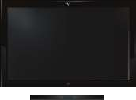






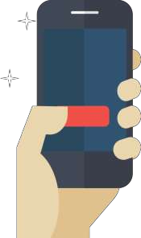








HOW IT WORKS
-
END TO END USER JOURNEY
App listens quietly in the
background for the trigger which is
delivered via the advertiser’s
content across Mobiles / Other
Women interests
Women Launch the Protect-Me app from their mobile
If the suspicious users is approaching towards women defined threshold Radius- – She gets an alert to be proactive or leave that Area/zone
App is fetching the data from Facebook/Google APIs / Other women on Previously suspected/Reported nearby people by other people on social Media and create Alert! Once that user cross a pre-defined Geo-Fencing Zone
ENGAGE
Once LBS trigger is activated, a non intrusive push notification is displayed to the women mobile.
The consumer can either choose to ignore or
engage with the notification
Advertiser is further offered
possibilities to cross target and re-
target the same audiences on the
digital landscape
Depending on the consumer’s response and using BSF
proprietary machine learning and artificial intelligence algorithms,
advertisers to derive insights on consumption patterns across myriads of parameters

Slide 6




BUSINESS
MODEL
LBS based offers for Highly rated advertisers on Facebook / Google and share commission on click/engagement happens for instant offers
Campaign services (CPM etc) for Advertisers
(brands and agencies). These can be programmatic, cross targeting and re- targeting campaigns (Real-Time) and Geo-Location based , via BSF
Monthly/Yearly subscription fee for women, who regularly go to shopping or travel in crowded places

